Slide 1

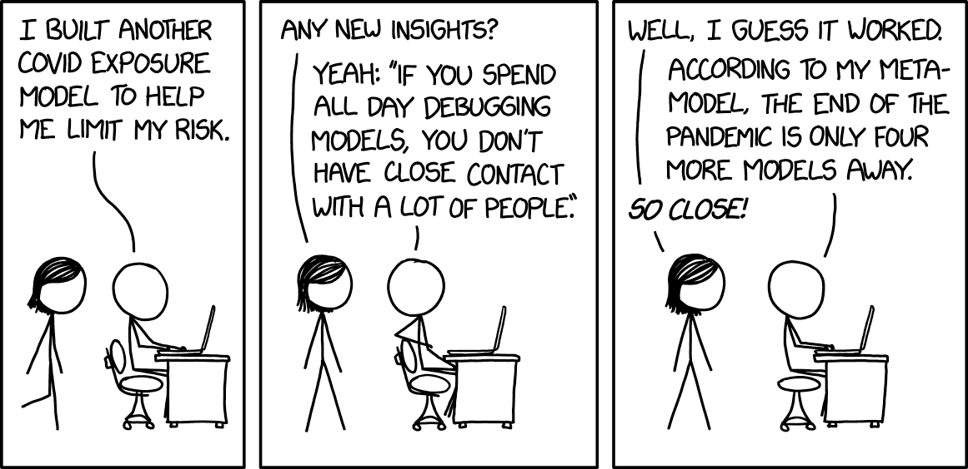
Intro to modeling
youtube.com/@hildug
Twitter: @hildug
Learning goals:
What is a model?
Analytical vs numerical solutions
What is a parameter?
Fitting parameters and optimization
optim

Slide 2

We can use models to explain relationships
Goal predict height of a tree from width of a tree
Height = B₀ + B₁ x width

Slide 3
We can use models to explain relationships
Goal predict height of a tree from width of a tree
Height = B₀ + B₁ x width
We want to obtain reliable coefficients so that we are able to investigate the relationships among the variables of interest

Slide 4

Analytical vs Numerical Approaches
An analytical solution involves calculating the exact answer
Often have proofs to derive the equations
A numerical solution means making guesses at the answer and testing whether the problem is solved well enough to stop
Analytical is exact; numerical is approximate

Slide 5
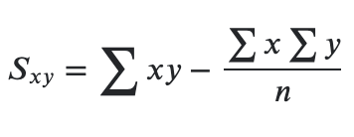
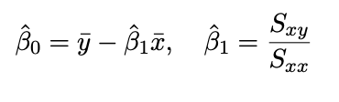
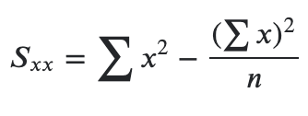
Analytical Solution to OLS
𝑆𝑥𝑥 is the sum of the squares of the difference between each 𝑥 and the mean 𝑥 value.
𝑆𝑥𝑦 is sum of the product of the difference between 𝑥 its means and the difference between 𝑦 and its mean.

